Slide 1
Matrices, Vectors & Fourier Analysis
Fall 20-21

Slide 2
Lecture-1
Matrix Algebra

Slide 3
Objective:
Discussion about different types of matrix
How to calculate Matrix addition and subtraction
How to calculate Matrix multiplication
How to find the determinant of a matrix

Slide 4
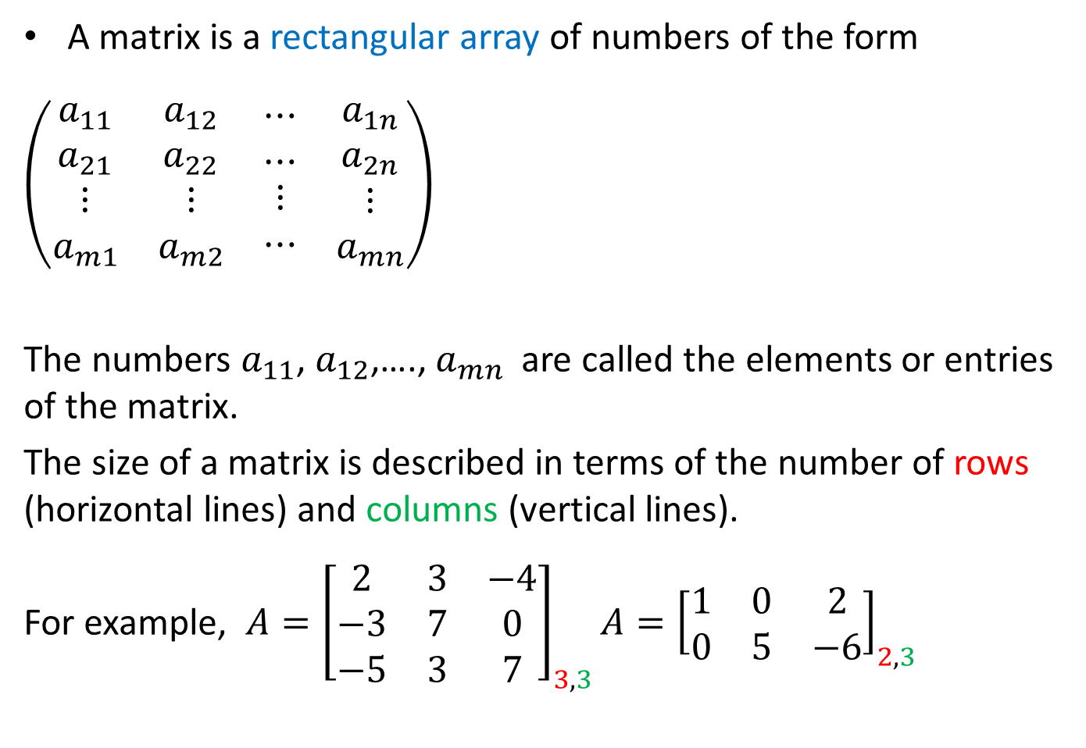
What is a matrix ?
A matrix is a rectangular array of numbers of the form
$\left(\begin{matrix}\begin{matrix}a_{11} \\ a_{21} \\ \begin{matrix}⋮ \\ a_{m1}\end{matrix}\end{matrix} & \begin{matrix}\begin{matrix}a_{12} \\ a_{22} \\ \begin{matrix}⋮ \\ a_{m2}\end{matrix}\end{matrix} & \begin{matrix}⋯ \\ ⋯ \\ \begin{matrix}⋮ \\ ⋯\end{matrix}\end{matrix} & \begin{matrix}a_{1n} \\ a_{2n} \\ \begin{matrix}⋮ \\ a_{mn}\end{matrix}\end{matrix}\end{matrix}\end{matrix}\right)$
The numbers $a_{11}$, $a_{12}$,…., $a_{mn}$ are called the elements or entries of the matrix.
The size of a matrix is described in terms of the number of rows (horizontal lines) and columns (vertical lines).
For example, $A={\left[\begin{matrix}2 & 3 & −4 \\ −3 & 7 & 0 \\ −5 & 3 & 7\end{matrix}\right]}_{3,3}A={\left[\begin{matrix}1 & 0 & 2 \\ 0 & 5 & −6\end{matrix}\right]}_{2,3}$

Slide 5
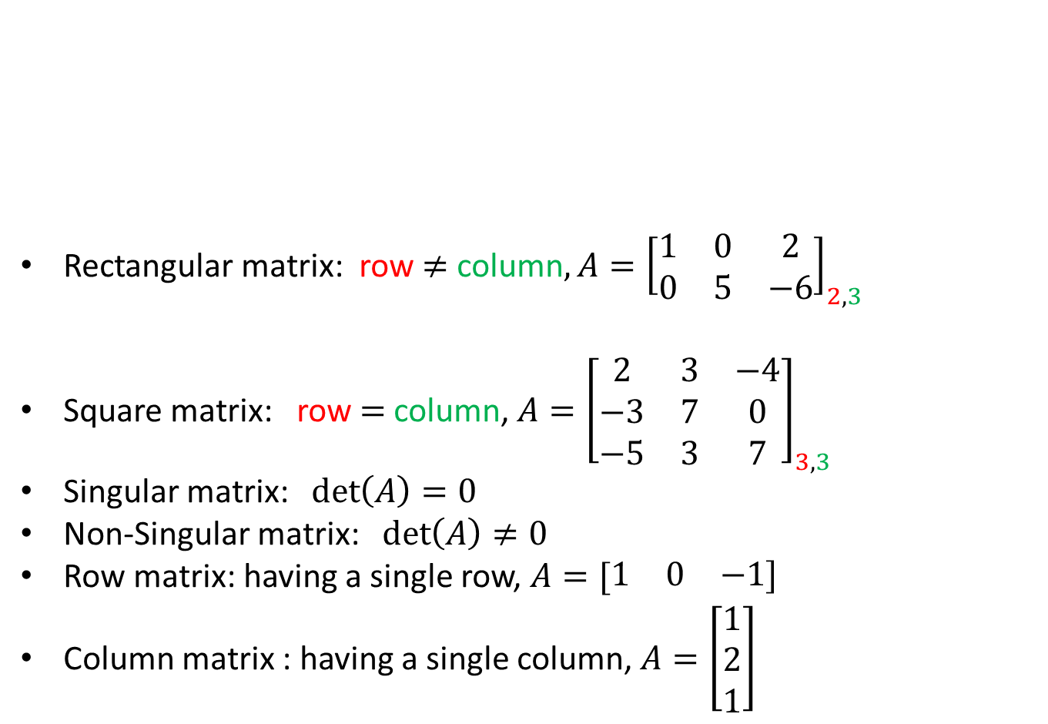
Classification of matrix
Rectangular matrix: row $≠$ column$, A={\left[\begin{matrix}1 & 0 & 2 \\ 0 & 5 & −6\end{matrix}\right]}_{2,3}$
Square matrix: row $=$ column, $A={\left[\begin{matrix}2 & 3 & −4 \\ −3 & 7 & 0 \\ −5 & 3 & 7\end{matrix}\right]}_{3,3}$
Singular matrix: $\det\left(A\right)=0$
Non-Singular matrix: $\det\left(A\right)≠0$
Row matrix: having a single row, $A=[\begin{matrix}1 & 0 & −1]\end{matrix}$
Column matrix : having a single column, $A=\left[\begin{matrix}1 \\ 2 \\ 1\end{matrix}\right]$
Matrix
Rectangular
Square
Singular
Nonsingular

Slide 6
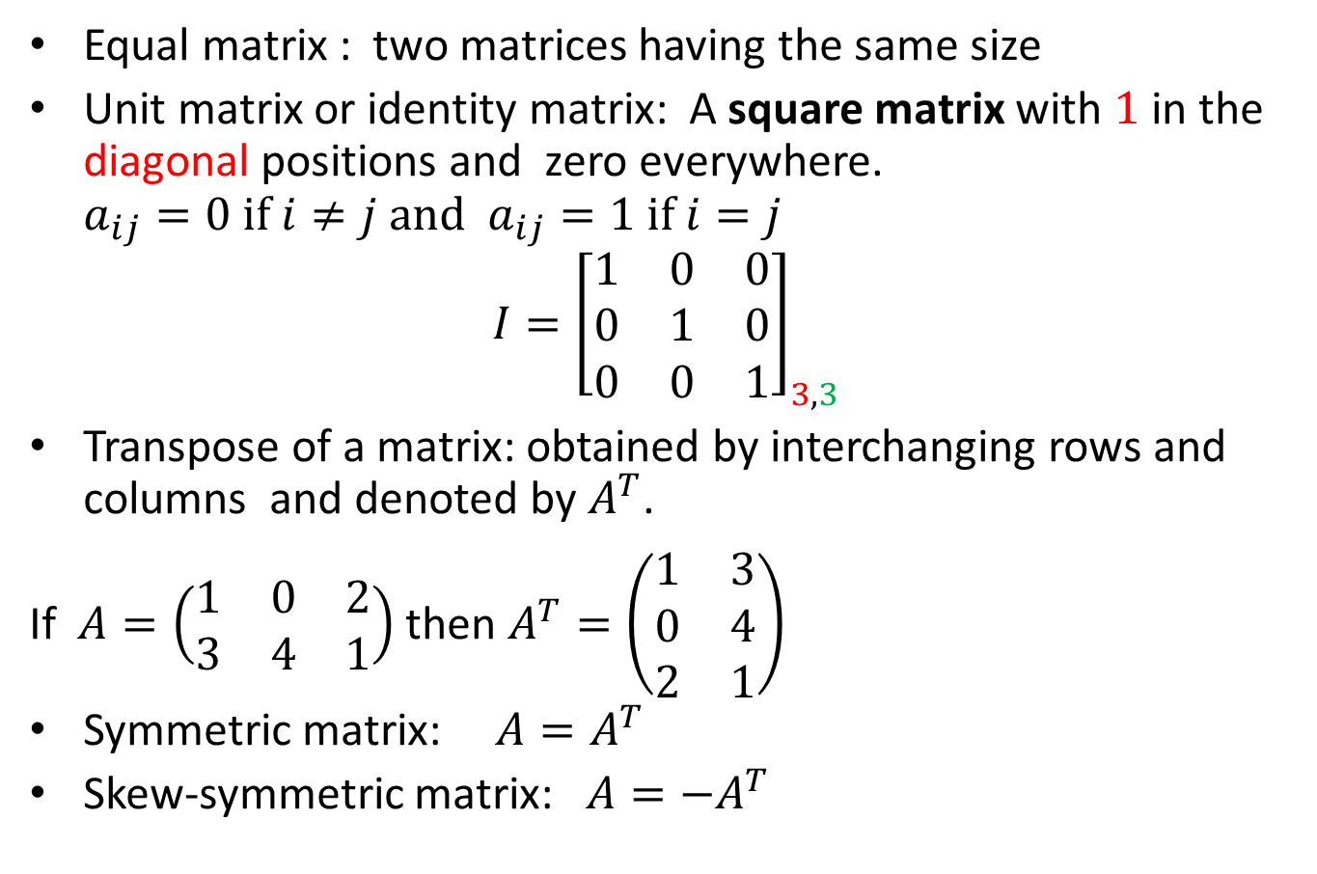
Classification of matrix (continued)
Equal matrix : two matrices having the same size
Unit matrix or identity matrix: A square matrix with $1$ in the diagonal positions and zero everywhere. $a_{ij}=0 if i≠j and{ a}_{ij}=1 if i=j$
$$I={\left[\begin{matrix}1 & 0 & 0 \\ 0 & 1 & 0 \\ 0 & 0 & 1\end{matrix}\right]}_{3,3}$$
Transpose of a matrix: obtained by interchanging rows and columns and denoted by $A^{T}$.
If $A=\left(\begin{matrix}1 & 0 & 2 \\ 3 & 4 & 1\end{matrix}\right)$ then $A^{T}=\left(\begin{matrix}1 & 3 \\ 0 & 4 \\ 2 & 1\end{matrix}\right)$
Symmetric matrix: ${A=A}^{T}$
Skew-symmetric matrix: ${A=−A}^{T}$

Slide 7
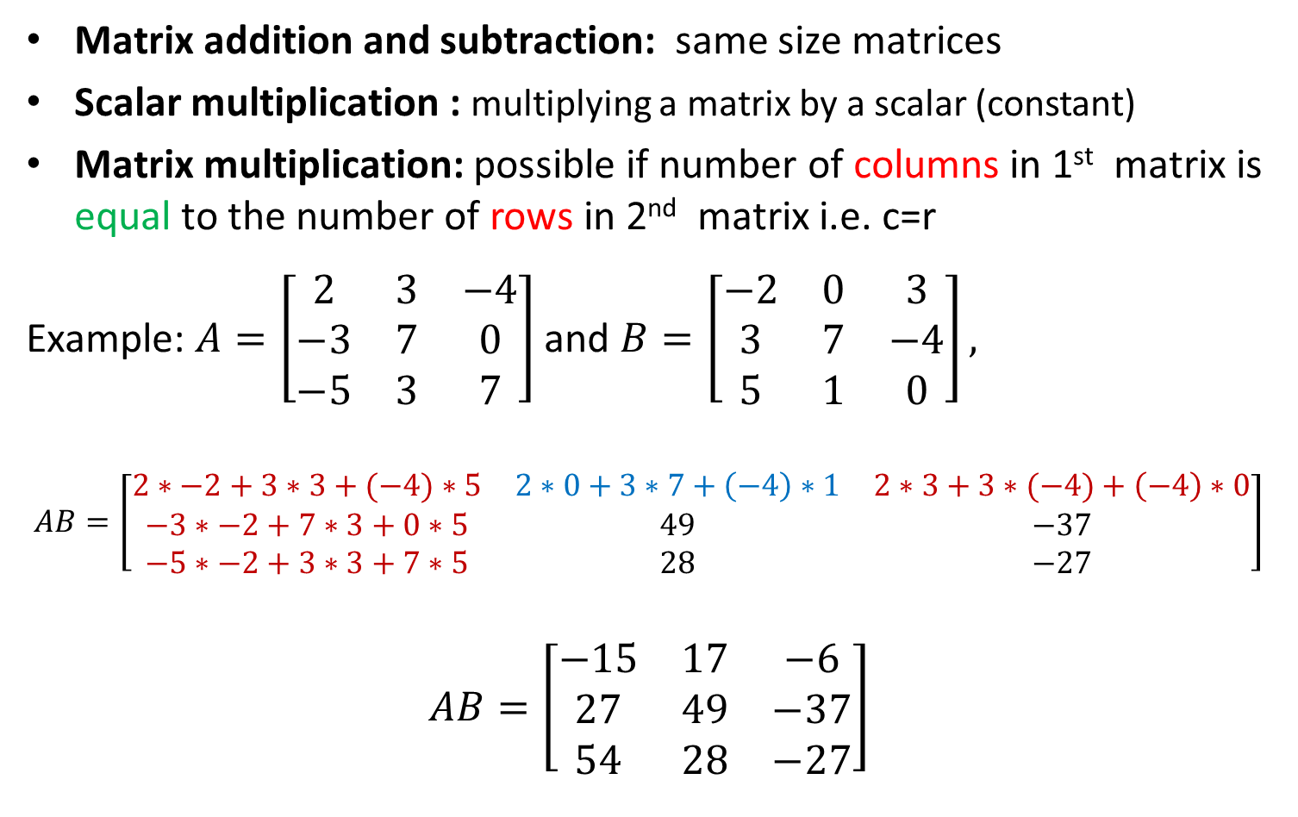
Matrix Algebra
Matrix addition and subtraction: same size matrices
Scalar multiplication : multiplying a matrix by a scalar (constant)
Matrix multiplication: possible if number of columns in 1st matrix is equal to the number of rows in 2nd matrix i.e. c=r
Example: $A=\left[\begin{matrix}2 & 3 & −4 \\ −3 & 7 & 0 \\ −5 & 3 & 7\end{matrix}\right]$and $B=\left[\begin{matrix}−2 & 0 & 3 \\ 3 & 7 & −4 \\ 5 & 1 & 0\end{matrix}\right],$
$$AB=\left[\begin{matrix}2∗−2+3∗3+(−4)∗5 & 2∗0+3∗7+\left(−4\right)∗1 & 2∗3+3∗(−4)+\left(−4\right)∗0 \\ −3∗−2+7∗3+0∗5 & 49 & −37 \\ −5∗−2+3∗3+7∗5 & 28 & −27\end{matrix}\right]$$
$$AB=\left[\begin{matrix}−15 & 17 & −6 \\ 27 & 49 & −37 \\ 54 & 28 & −27\end{matrix}\right]$$

Slide 8
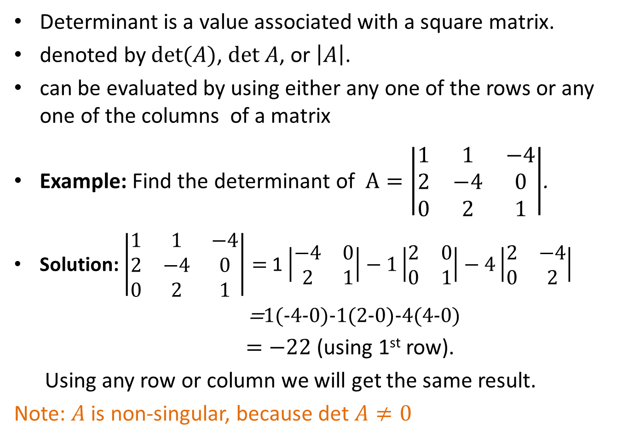
Determinant
Determinant is a value associated with a square matrix.
denoted by $det(A)$, $det A$, or $\left|A\right|$.
can be evaluated by using either any one of the rows or any one of the columns of a matrix
Example: Find the determinant of $A=\left|\begin{matrix}1 & 1 & −4 \\ 2 & −4 & 0 \\ 0 & 2 & 1\end{matrix}\right|$.
Solution: $\left|\begin{matrix}1 & 1 & −4 \\ 2 & −4 & 0 \\ 0 & 2 & 1\end{matrix}\right|=$ 1$\left|\begin{matrix}−4 & 0 \\ 2 & 1\end{matrix}\right|−1\left|\begin{matrix}2 & 0 \\ 0 & 1\end{matrix}\right|−4\left|\begin{matrix}2 & −4 \\ 0 & 2\end{matrix}\right|$
=1(-4-0)-1(2-0)-4(4-0)
$=−22$ (using 1st row).
Using any row or column we will get the same result.
Note: $A$ is non-singular, because det $A≠0$

Slide 9
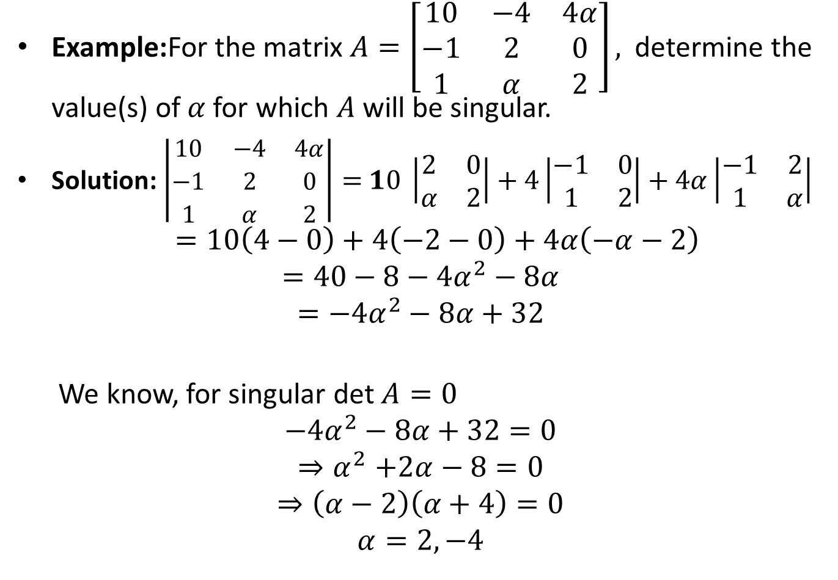
Determinant
Example:For the matrix$A=\left[\begin{matrix}10 & −4 & 4α \\ −1 & 2 & 0 \\ 1 & α & 2\end{matrix}\right],$determine the value(s) of$α$for which $A$ will be singular.
Solution: $\left|\begin{matrix}10 & −4 & 4α \\ −1 & 2 & 0 \\ 1 & α & 2\end{matrix}\right|=$ $10 \left|\begin{matrix}2 & 0 \\ α & 2\end{matrix}\right|+4\left|\begin{matrix}−1 & 0 \\ 1 & 2\end{matrix}\right|+4α\left|\begin{matrix}−1 & 2 \\ 1 & α\end{matrix}\right|$
$$=10\left(4−0\right)+4\left(−2−0\right)+4α\left(−α−2\right)$$
$$=40−8−4α^{2}−8α$$
$$=−4α^{2}−8α+32$$
We know, for singular det $A=0$
$$−4α^{2}−8α+32=0$$
$${⇒α}^{2}+2α−8=0$$
$$⇒\left(α−2\right)\left(α+4\right)=0$$
$$α=2,−4$$

Slide 10
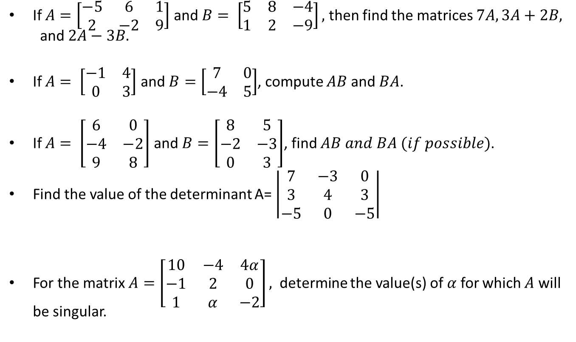
Sample Question
If $A=\left[\begin{matrix}−5 & 6 & 1 \\ 2 & −2 & 9\end{matrix}\right]$ and $B= \left[\begin{matrix}5 & 8 & −4 \\ 1 & 2 & −9\end{matrix}\right],$ then find the matrices $7A, 3A+2B,$and $2A−3B.$
If $A= \left[\begin{matrix}−1 & 4 \\ 0 & 3\end{matrix}\right]$ and $B=\left[\begin{matrix}7 & 0 \\ −4 & 5\end{matrix}\right]$, compute $AB$ and $BA$.
If $A= \left[\begin{matrix}6 & 0 \\ −4 & −2 \\ 9 & 8\end{matrix}\right]$ and $B=\left[\begin{matrix}8 & 5 \\ −2 & −3 \\ 0 & 3\end{matrix}\right]$, find $AB and BA (if possible)$.
Find the value of the determinant A= $\left|\begin{matrix}7 & −3 & 0 \\ 3 & 4 & 3 \\ −5 & 0 & −5\end{matrix}\right|$
For the matrix$A=\left[\begin{matrix}10 & −4 & 4α \\ −1 & 2 & 0 \\ 1 & α & −2\end{matrix}\right],$determine the value(s) of$α$for which $A$ will be singular.

Slide 11
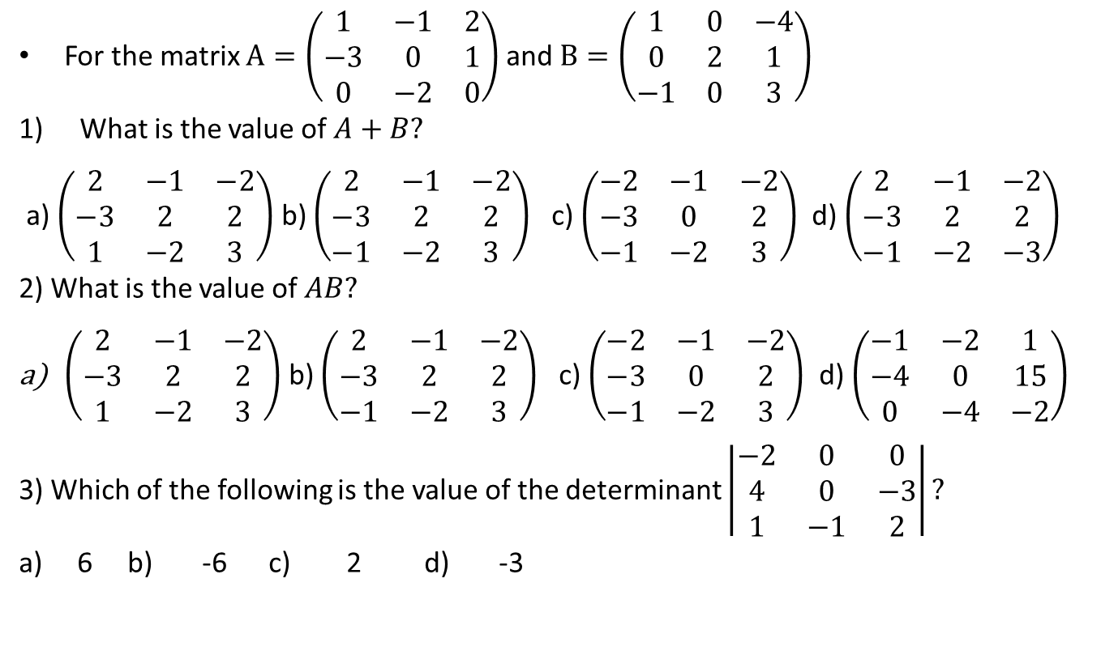
Sample MCQ
For the matrix $A=\left(\begin{matrix}1 & −1 & 2 \\ −3 & 0 & 1 \\ 0 & −2 & 0\end{matrix}\right)$ and $B=\left(\begin{matrix}1 & 0 & −4 \\ 0 & 2 & 1 \\ −1 & 0 & 3\end{matrix}\right)$
What is the value of $A+B?$
a) $\left(\begin{matrix}2 & −1 & −2 \\ −3 & 2 & 2 \\ 1 & −2 & 3\end{matrix}\right)$ b) $\left(\begin{matrix}2 & −1 & −2 \\ −3 & 2 & 2 \\ −1 & −2 & 3\end{matrix}\right)$ c) $\left(\begin{matrix}−2 & −1 & −2 \\ −3 & 0 & 2 \\ −1 & −2 & 3\end{matrix}\right)$ d) $\left(\begin{matrix}2 & −1 & −2 \\ −3 & 2 & 2 \\ −1 & −2 & −3\end{matrix}\right)$
2) What is the value of $AB?$
$\left(\begin{matrix}2 & −1 & −2 \\ −3 & 2 & 2 \\ 1 & −2 & 3\end{matrix}\right)$ b) $\left(\begin{matrix}2 & −1 & −2 \\ −3 & 2 & 2 \\ −1 & −2 & 3\end{matrix}\right)$ c) $\left(\begin{matrix}−2 & −1 & −2 \\ −3 & 0 & 2 \\ −1 & −2 & 3\end{matrix}\right)$ d) $\left(\begin{matrix}−1 & −2 & 1 \\ −4 & 0 & 15 \\ 0 & −4 & −2\end{matrix}\right)$
3) Which of the following is the value of the determinant $\left|\begin{matrix}−2 & 0 & 0 \\ 4 & 0 & −3 \\ 1 & −1 & 2\end{matrix}\right|?$
a) 6 b) -6 c) 2 d) -3

Slide 12
Outcome
After this lecture students
Will know what is a matrix and types of matrices.
Will be able to add, subtract and multiply matrices.
Will be able to find the determinant of a matrix

Slide 13
Next class
Matrix inverse
Row Echelon Form (REF)
Reduced Row Echelon Form (RREF)

